Slide 1
Experiment Summary
Experiment Name
: 2018-06-19 2377-009 TPP1 qPCR Run 3
Experiment Type
: Standard Curve
File Name
: 2018-06-19 2377-009 TPP1 qPCR Run 3.eds
Date Modified
: Tue Jun 19 14:43:21 EDT 2018
Date Created
: Tue Jun 19 08:12:35 EDT 2018
Run Started
: Tue Jun 19 14:26:57 EDT 2018
Run Finished
: Tue Jun 19 15:59:17 EDT 2018
Run Duration
: 92 minutes 20 seconds
User
:
Number of Wells Used
: 96
Number of Wells with Results
: 96
Instrument Name
: 278870909
Date Printed
: Jun 19, 2018
2018-06-19 2377-009 TPP1 qPCR Run 3

Slide 2
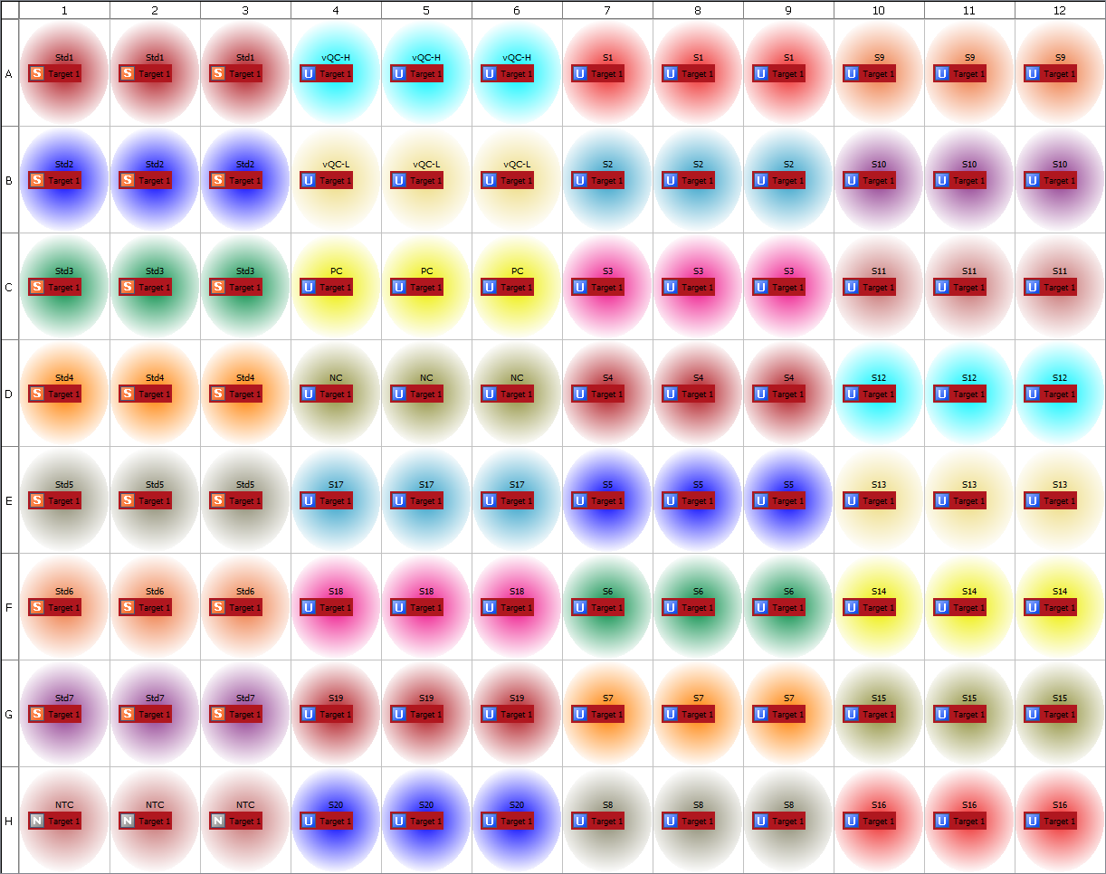
Plate Layout
2018-06-19 2377-009 TPP1 qPCR Run 3

Slide 3
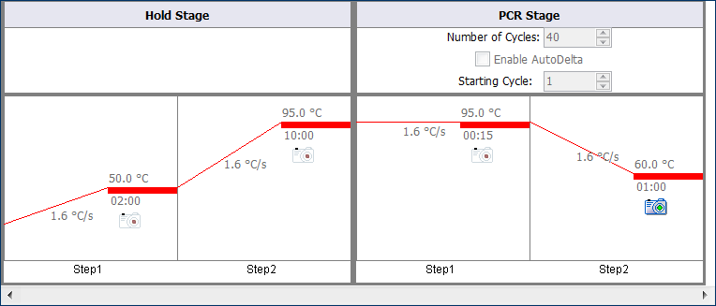
Thermal Method
2018-06-19 2377-009 TPP1 qPCR Run 3

Slide 4
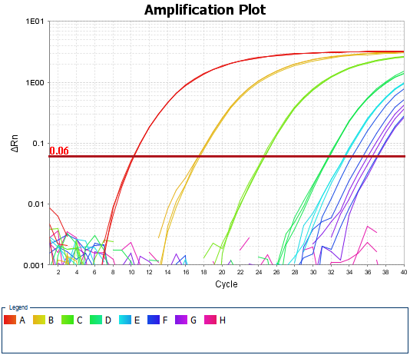
Amplification Plot
2018-06-19 2377-009 TPP1 qPCR Run 3

Slide 5
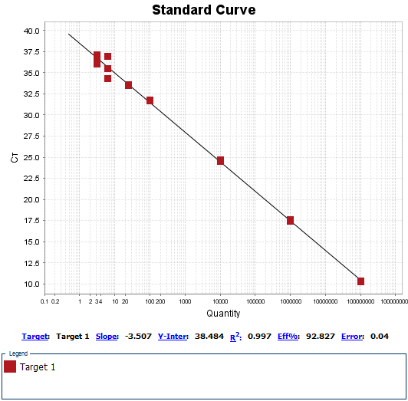
Standard Curves
2018-06-19 2377-009 TPP1 qPCR Run 3

